Slide 1
Serviced Apartment Market in Phnom Penh Cambodia

Slide 2
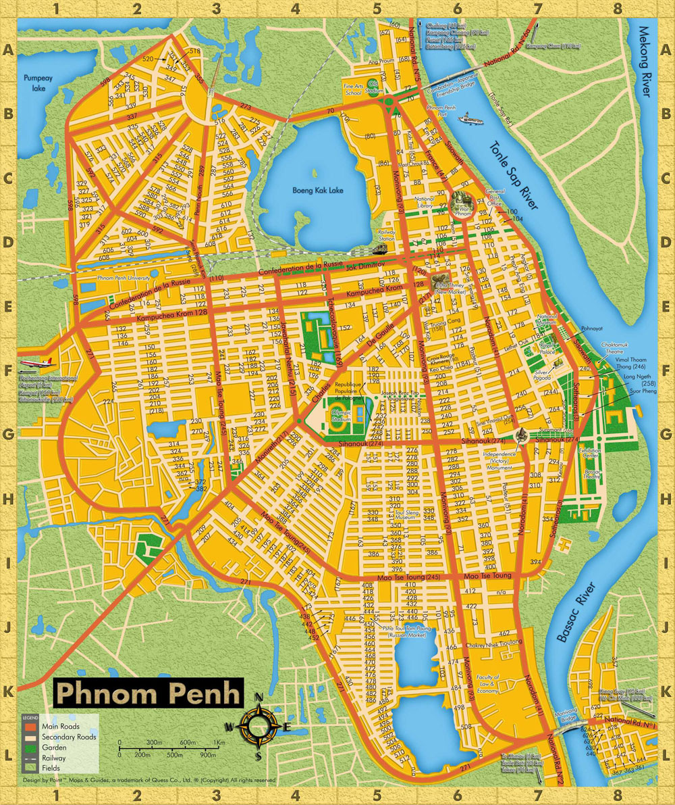
Noblesse Residence
De Castle Royal

Slide 3
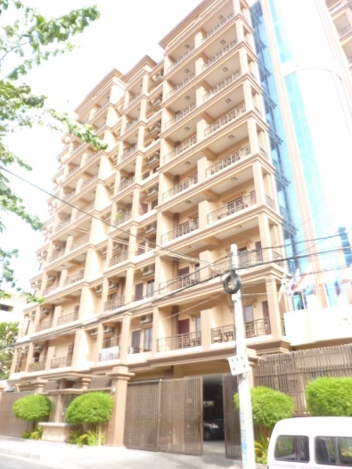
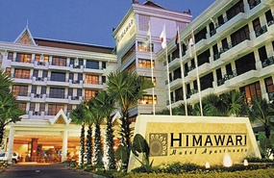
Serviced Apartments, Phnom Penh, Cambodia
Unit Supplies research - examples
NAME | HAMPTONS
ROOM | 54
RENT | $1,200 (1-bed) $2,700 (2-bed) $3,000 (3-bed)
OCCUPANCY | 50
NAME
NAME | HIMAWARI
Address: | No. 313, Sisowath Quay
ROOM | 54
RENT | $3,200 (1-bed) $4,500 (2-bed) $5,200 (3-bed)
OCCUPANCY | 50

Slide 4
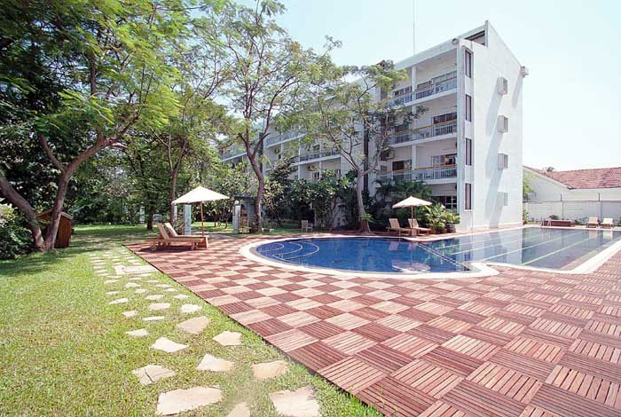
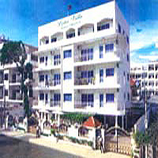
Serviced Apartments, Phnom Penh, Cambodia
Unit supplies research- examples
NAME | Embassy Place
ROOM | 34
RENT | $2,200 (1-bed) $2,500 (2-bed) $2,950 (3-bed)
OCCUPANCY | 32
NAME | Lotus Villa
ROOM | 28
RENT | $ 800 (1-bed) $1,300 (2-bed)
OCCUPANCY | 26

Slide 5
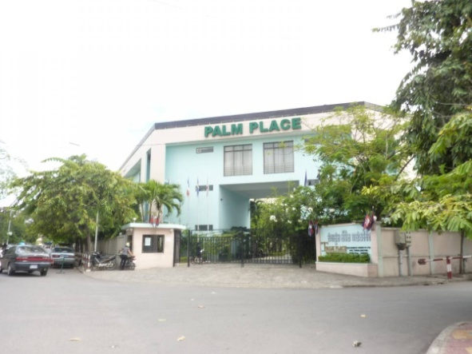
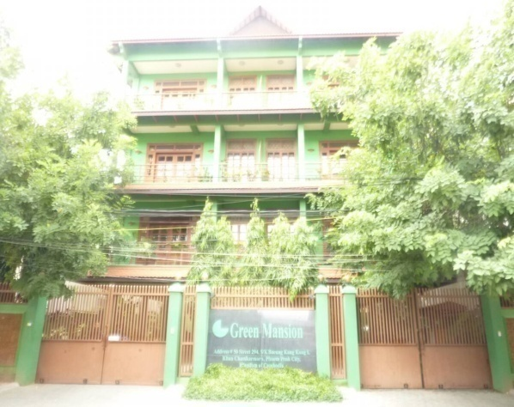
Serviced Apartments, Phnom Penh, Cambodia
Unit supplies research- examples
NAME | Palm Place
ROOM | 28
RENT | $1,900 (1-bed) $2,500 (2-bed) $4,600 (3-bed)
OCCUPANCY | 25
NAME | Green Mansion I
ROOM | 6
RENT | $1,200 (2-bed)
OCCUPANCY | 5

Slide 6
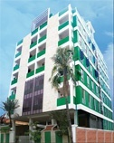
Serviced Apartments, Phnom Penh, Cambodia
Unit supplies research - examples
NAME | Green Mansion II
ROOM | 36
RENT | $1,300(1-bed) $1,500(2-bed) $1,850 (3-bed)
OCCUPANCY | 36
NAME | Green Mansion III
ROOM | 25
RENT | $1,300 (1-bed) $1,600 (2-bed) $2,000 (3-bed)
OCCUPANCY | 25

Slide 7
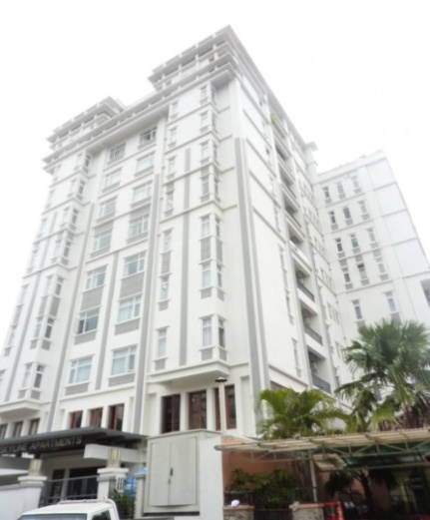
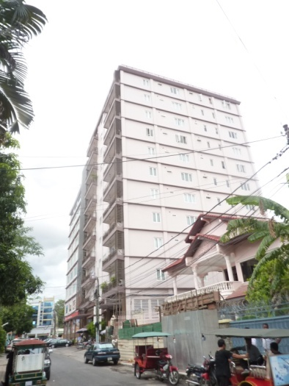
Serviced Apartments, Phnom Penh, Cambodia
Unit supplies research- examples
NAME | Skyline
ROOM | 36
RENT | $1,200 (1-bed) $1,700 (2-bed) $3,000 (3-bed)
OCCUPANCY | 34
NAME | Borita
ROOM | 40
RENT | $1,100 (1-bed) $1,400 (2-bed) $2,700 (3-bed)
OCCUPANCY | 35

Slide 8
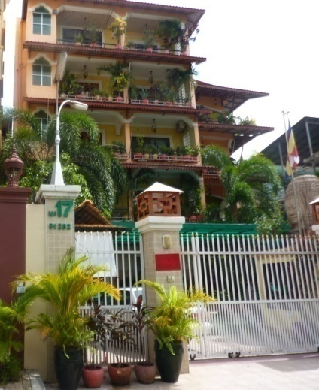
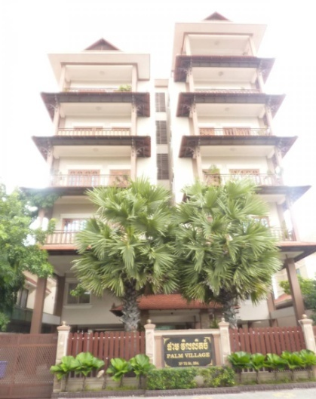
Serviced Apartments, Phnom Penh, Cambodia
Unit supplies research - examples
NAME | Tum Chandara
ROOM | 20
RENT | $ 500 (1-bed) $ 700 (2-bed) $1,300 (3-bed)
OCCUPANCY | 19
NAME | Palm Village
ROOM | 12
RENT | $ 800 (1-bed) $1,200 (2-bed)
OCCUPANCY | 12

Slide 9
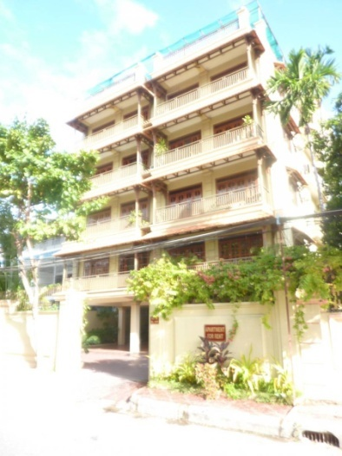
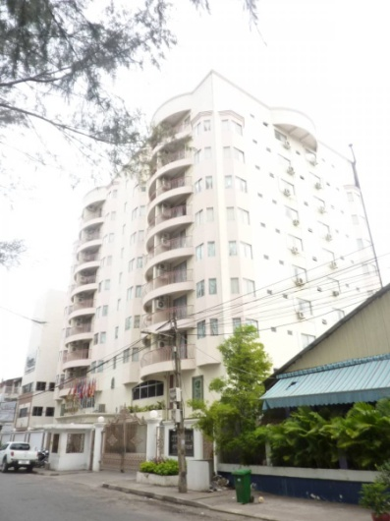
Serviced Apartments, Phnom Penh, Cambodia
Unit supplies research- examples
NAME | Sarah
ROOM | 16
RENT | $ 700 (1-bed) $ 800 (2-bed)
OCCUPANCY | 15
NAME | City Villa
ROOM | 64
RENT | $ 600 (1-bed) $ 800 (2-bed) $1,800 (3-bed)
OCCUPANCY | 57

Slide 10
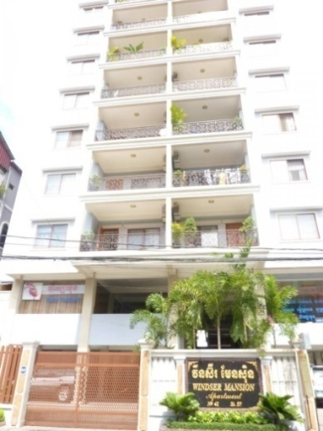
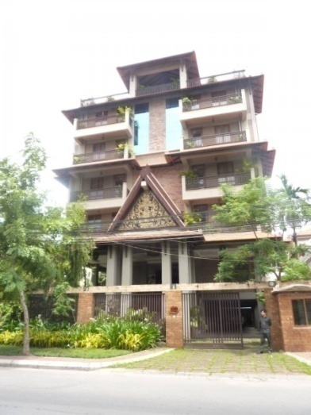
Serviced Apartments, Phnom Penh, Cambodia
Unit supplies research - examples
NAME | Windser Mansion
ROOM | 28
RENT | $1,100 (2-bed) $2,400 (3-bed) $2,500 (4-bed)
OCCUPANCY | 26
NAME | Motanak
ROOM | 16
RENT | $ 900 (1-bed) $1,600 (2-bed) $2,400 (3-bed)
OCCUPANCY | 16

Slide 11
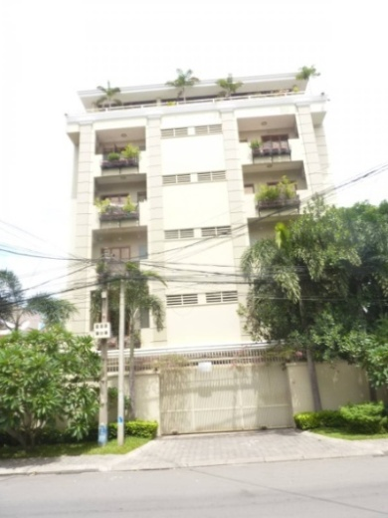
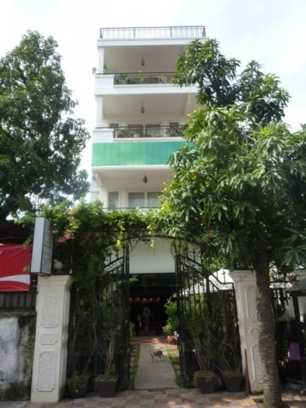
Serviced Apartments, Phnom Penh, Cambodia
Unit supplies research - examples
NAME | Mekong
ROOM | 14
RENT | $750 (1-bed) $850 (2-bed)
OCCUPANCY | 14
NAME | Vireak Khmer
ROOM | 5
RENT | $750 (1-bed)
OCCUPANCY | 5

Slide 12
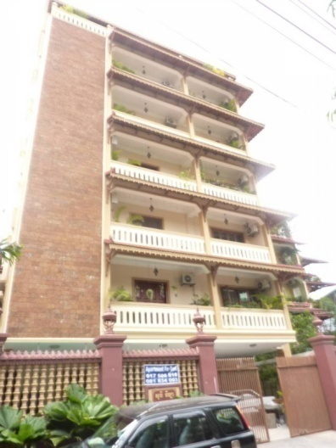
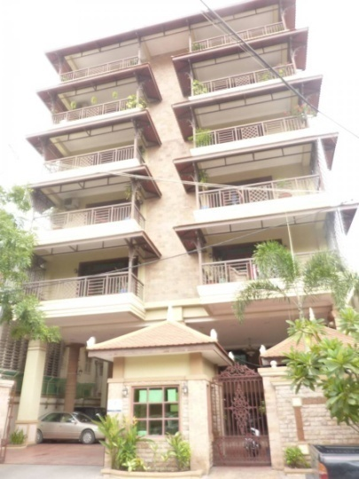
Serviced Apartments, Phnom Penh, Cambodia
Unit supplies research - examples
NAME | Sony Villa
ROOM | 9
RENT | $ 850 (1-bed) $1,100 (2-bed) $1,600 (3-bed)
OCCUPANCY | 9
NAME | Maliya
ROOM | 18
RENT | $850 (1-bed) $1,300 (2-bed) $2,100 (3-bed)
OCCUPANCY | 16

Slide 13
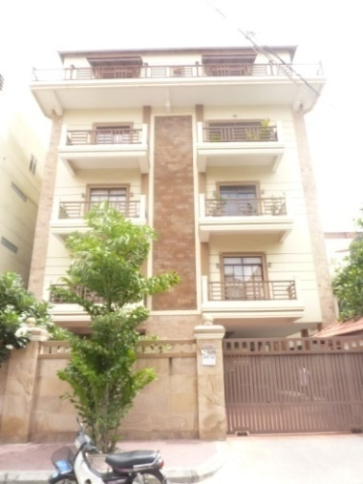
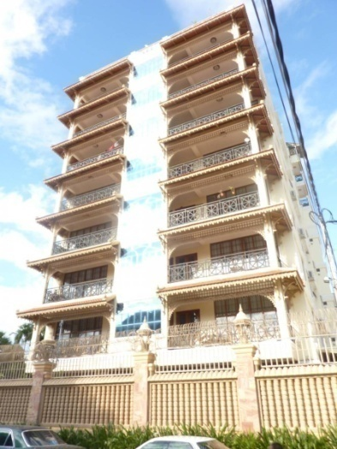
Serviced Apartments, Phnom Penh, Cambodia
Unit supplies research - examples
NAME | Apartment No 33
ROOM | 6
RENT | $750 (1-bed) $850 (2-bed)
OCCUPANCY | 6
NAME | Apartment on St.310
ROOM | 28
RENT | $ 950 (1-bed) $1,400 (2-bed) $2,400 (3-bed) $2,750 (3-bed)
OCCUPANCY | 25

Slide 14
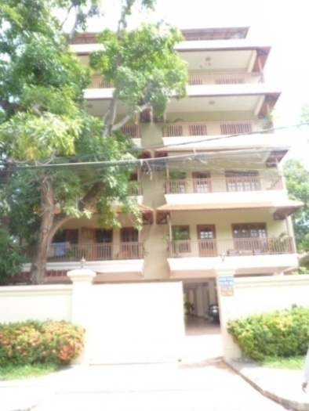
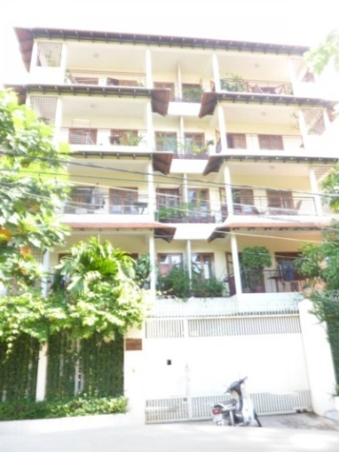
Serviced Apartments, Phnom Penh, Cambodia
Unit supplies research - examples
NAME | Apartment No.3
ROOM | 8
RENT | $ 650 (2-bed)
OCCUPANCY | 8
NAME | Apartment No.15
ROOM | 13
RENT | $ 450 (1-bed) $ 850 (2-bed)
OCCUPANCY | 13

Slide 15
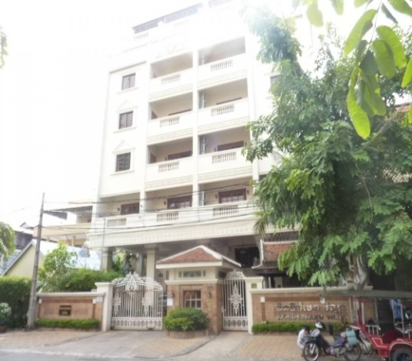
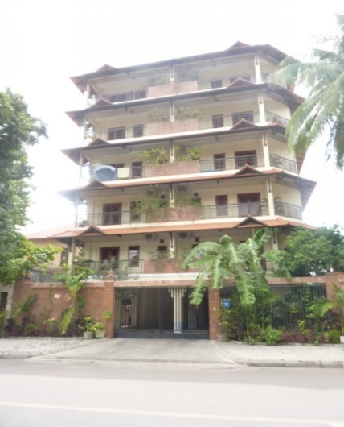
Serviced Apartments, Phnom Penh, Cambodia
Unit supplies research - examples
NAME | Wonderland Villa
ROOM | 14
RENT | $ 850 (1-bed) $ 1,250 (2-bed)
OCCUPANCY | 13
NAME | OKO
ROOM | 10
RENT | $1,100 (2-bed)
OCCUPANCY | 10

Slide 16
Serviced Apartments, Phnom Penh, Cambodia
Regarding to the figures chart of unit supply Apartment in Phnom Penh, it is shown us that most of the people, they are prefer to rent in 2-bedroom (53.05%). Next , it is 1-bedroom (30.54%) and the rest are 3-bedroom (14.79%) and 4-bedroom (1.60%).

Slide 17
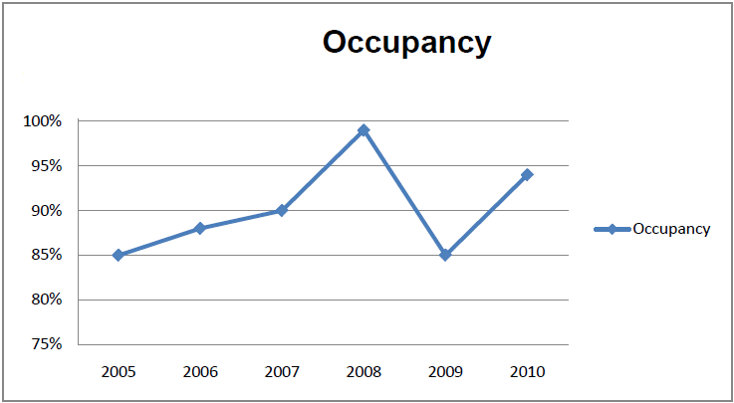
Serviced Apartments, Phnom Penh, Cambodia
2005-2008: The occupancy rate of serviced apartments decreased sharply from 85% to 99% until 2008.
In 2009 occupancy rates dropped to 85% over a year.
In 2010, occupancy rates have recovered strongly to 94%.

Slide 18
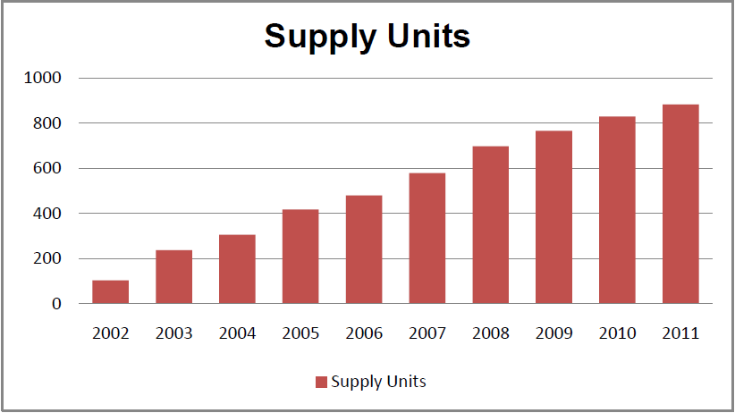
Serviced Apartments, Phnom Penh, Cambodia
There are no internationally branded serviced apartments in Phnom Penh, and not the high- rise building
The supply of domestic serviced apartments has grown up since 2002, it now stands at 883.

Slide 19
Thank you!

